Slide 1
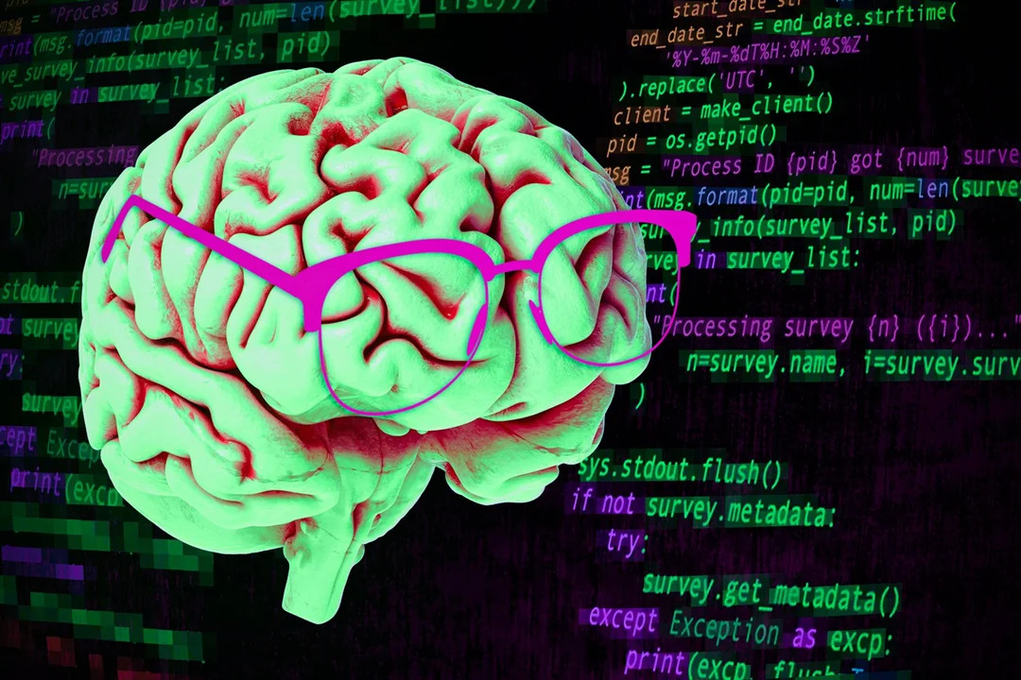
How Language Design Affects Human's Mind
-Ruby vs. Virtual Language in Nineteen Eighty-Four-
Composed By: Hayato Ishida
For Japanese version, click here
Updated On: 01 September 2025

Slide 2

About Me
Accounts
GitHub: @hayat01sh1da
X: @hayat01sh1da
LinkedIn: @hayat01sh1da
Speaker Deck: @hayat01sh1da
Docswell: @hayat01sh1da
Occupation: Software Engineer
Things I Am Into
Linguistics
Singing at Karaoke
Listening to Music
Watching Movies
Cat Feeding

Slide 3
Licences / Certifications
English
TOEIC® Listening & Reading 915: Certified on December 2019
Engineering
Information Security Management: Certified on November 2017
Applied Information Technology Engineer: Certified on June 2017
Fundamental Information Technology Engineer: Certified on November 2016
IT Passport: Certified on April 2016
Others
Abacus 2nd Class: Certified on June 2002
Mental Arithmetic 3rd Class: Certified on February 2001

Slide 4
Skill Stack
Languages
Japanese: Native Proficiency
English: Full professional Proficiency
Development
Backend: Ruby(Ruby on Rails), Python
Frontend: TypeScript + React.js, TypeScript +Vue.js
Database: MySQL, PostgreSQL, MongoDB
Architecture: Monolith, Modular Monolith
Hosting: AWS ESK
Versioning: Git, GitHub
CI/CD: GitHub Actions, ArgoCD
Monitoring: Datadog, Sentry

Slide 5
Work Histories
Period | Genre | Position | Jobs
Aug 2021 - Present | Saas(Educational Service) | Software Engineer | Backend Development Frontend Development CI/CD Maintenance Weekly Release Manager Troubleshooting Documentation Technical Debt Resolution Tech Blog Entries LT Speaker
Feb 2020 - Dec 2020 | SaaS(Chatbot Platform) | Backend Engineer | Backend Development Documentation Technical Debt Resolution Inspection of Alternative API

Slide 6
Work Histories
Period | Genre | Position | Jobs
Jun 2018 - Jan 2020 | Contract-basis Developer | Software Engineer | Backend Development Frontend Development Troubleshooting Quality Assurance Tech Blog Entries
Apr 2016 - Jan 2018 | System Engineering Service | System Engineer | Corporate Account Admin Windows Server Maintenance Security Admin Assistant Internationalisation / Localisation

Slide 7
International-Exchange Activities
Activities in University
English Linguistics Seminar(Focusing on Mass Media English)
International-Exchange Clubs(The 2nd Year)
International-Exchange Programmes conducted by Japan Cabinet Office(2013 - 2016)
Japanese Linguistics Course(The Final Year)
Overseas Life Experience
Working Holiday in Australia(April 2014 - March 2015)
Language School for 1 month in Sydney
Work for 6 Months in Hamilton Island Resort
Volunteering for 1 Month as Assistant Teacher of Japanese Language at St Ives High School in NSW
Other Activities
Keep Everyday Journal in English (April 2014 - Present)
Sunrise Toastmasters Club(February 2017 - March 2018)
Vital Japan(January 2018 - July 2019, October 2022 - February 2023)
Self Learning and Training of English Language
Participation Ruby-Related Tech Conferences

Slide 8
Agenda
My Themes Today
Natural Languages and Human's Mind
Programming Languages and Human's Mind
Ruby vs. Xxxspeak
Conclusion
References

Slide 9
1. My Themes Today

Slide 10
1. My Themes Today
To NOT delicate myself to prosperity of Ruby at all.
To earnestly discuss something NEITHER practical NOR technical.
To take audience to a short journey of a linguistic thought experiment.

Slide 11
2. Natural Languages and Human's Mind

Slide 12
2. Natural Languages and Human's Mind
Natural Language and Communication
We are involved in these activities via natural language as the interface.
Category of Communication | Activity | Act / Factor
External Communication = Social Activity | Exchange Information with People | Asking Questions Making Assertions
 | Regulate and Coordinate Behaviours of People | Making Requests Giving Orders Making Offers Making Promises
Internal Communication = Mental Activity | Organise Knowledge in Oneself = Classification of the Objects of the World | Living vs. Non-Living Plants vs. Animals Humans vs. Other Animals
 | Reason and Draw an Inference in Oneself = Read between the Lines | What it means What it implies

Slide 13
2. Natural Languages and Human's Mind
Newspeak in Nineteen Eighty-Four written by George Orwell
The language was designed and partly enforced in Oceanic society in the novel.
The main purpose was to regulate exterminate anti-social political thoughts by eliminating words related to them along with the concepts.
That is to say, we also would lose the corresponding concept if we lost a word.
Let's discuss differences between Oldspeak(Present-Day English) and Newspeak.
Attribute | Oldspeak(Present-Day English) | Newspeak
Vocabulary and Expressions | Richer every second | Poorer every year
Regulation of Human's Mind | Looser | Stricter
Flexibility of Expressions | Extraordinarily High | Not Flexible at all
Ambiguity | Less | More
Cognitive Load | Lower(Low Context) | Higher(High Context)
Unanimity of Expressions | Hard | Easy

Slide 14
3. Programming Languages and Human's Mind

Slide 15
3. Programming Languages and Human's Mind
Programming Language and Communication
We are involved in these activities via programming language as the interface.
Category of Communication | Activity | Act / Factor
External Communication = Social Activity | Exchange Information with People | Asking Questions Making Assertions
 | Regulate and Coordinate Behaviours of not just Computers but People | Making Requests Giving Orders Making Offers Making Promises
Internal Communication = Mental Activity | Organise and Apply Knowledge in Oneself = Design and Implementation | Controller vs. Model ActiveRecord vs. CQRS Monolith vs. Microservice
 | Reason and Draw an Inference in Oneself = Read between the Codes | What it implements What requirements it implies

Slide 16
3. Programming Languages and Human's Mind
Ruby created by Mr. Yukihiro Matsumoto(generally called Matz)
Ruby is outstanding in its Linguistic Cognitive Consideration learned from Perl.
The feature provides Rubyists with a wonderful coding experience.
Let's discuss differences between Ruby and Python, another OOP.
Attribute | Ruby | Python
Vocabulary and Expressions | Rich | Limited
Regulation of Human's Mind | Looser | Stricter
Flexibility of Expressions | Higher | Lower
Ambiguity | Less(Naming convention) | Less(Language design)
Cognitive Load | Hard to Evaluate(High and/or Low) | Hard to Evaluate(High and/or Low)
Unanimity of Expressions | Hard(Easier with tool introduction) | Easy

Slide 17
4. Ruby vs. Xxxspeak

Slide 18
4. Ruby vs. Xxxspeak
Ruby vs. Newspeak
The comparison below shows the less mutual features.
Attribute | Ruby | Newspeak
Vocabulary and Expressions | Rich | Poorer every year
Regulation of Human's Mind | Looser | Stricter
Flexibility of Expressions | Higher | Not Flexible at all
Ambiguity | Less(Naming convention) | More
Cognitive Load | Hard to Evaluate(High and/or Low) | Higher(High Context)
Unanimity of Expressions | Hard(Easier with tool introduction) | Easy

Slide 19
4. Ruby vs. Xxxspeak
Ruby vs. Oldspeak
The comparison below shows the more mutual features because both of them think highly of Convention over Configuration.
Attribute | Ruby | Oldspeak(Present-Day English)
Vocabulary and Expressions | Rich | Richer every second
Regulation of Human's Mind | Looser | Looser
Flexibility of Expressions | Higher | Extraordinarily High
Ambiguity | Less(Naming convention) | Less
Cognitive Load | Hard to Evaluate(High and/or Low) | Lower(Low Context)
Unanimity of Expressions | Hard(Easier with tool introduction) | Hard

Slide 20
4. Ruby vs. Xxxspeak
[Appendix] Python vs. Newspeak
The comparison below shows the more mutual features because both of them are think highly of Configuration over Convention.
Attribute | Python | Newspeak
Vocabulary and Expressions | Limited | Poorer every year
Regulation of Human's Mind | Stricter | Stricter
Flexibility of Expressions | Lower | Not Flexible at all
Ambiguity | Less(Language design) | More
Cognitive Load | Hard to Evaluate(High and/or Low) | Higher(High Context)
Unanimity of Expressions | Easy | Easy

Slide 21
5. Conclusion

Slide 22
5. Conclusion
The following principles apply to both of natural and programming languages.
Rich vocabulary in terms of communication interface provides
higher flexibility of expressions thanks to looser regulation of human's mind
higher cognitive load due to too rich idioms to properly handle
more costs for arrival at the agreement to define ubiquitous expressions within the same community
Poor vocabulary in terms of communication interface provides
lower flexibility of expressions owing to stricter regulation of human's mind
lower cognitive load thanks to so poor idioms as to easily handle
less costs for arrival at the agreement to define ubiquitous expressions within the same community

Slide 23
6. References

Slide 24
6. References
Michael L. Geis, Language and Communication, Oxford, OUP, 2001
George Orwell, Nineteen Eighty-Four, the United Kingdom, Harvill Secker, 1949
Xiaohui Zou, The Cognitive Features of Programming Language and Natural Language, Switzerland, Springer, Cham, 2018
Evelina Fedorenko, Anna Ivanova, Riva Dhamal, Marina Umaschi Bers, The Language of Programming: A Cognitive Perspective, Amsterdam, 2019
Colin S. Gordon, The Linguistics of Programming, Philadelphia, Drexel University, 2024

Slide 25
6. References
Hayato Ishida, Dive Deeper into Present-Day English Vol.1 -What English Is-, Tokyo, 2024
Hayato Ishida, Economy of Efforts, Tokyo, 2025
Hayato Ishida, Recommendation of Comparative Linguistics -Learn Identity of Programming Language from Ruby vs. Python-, Tokyo, 2025
Hayato Ishida, Road to Ruby for A Linguistics Nerd, Tokyo, 2025
Hayato Ishida, High-Level Programming Languages in AI Era -Human Thought and Mind-, Tokyo, 2025

Slide 26
EOD

